Slide 1


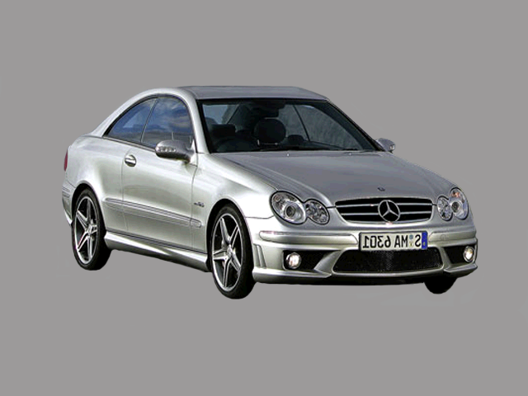
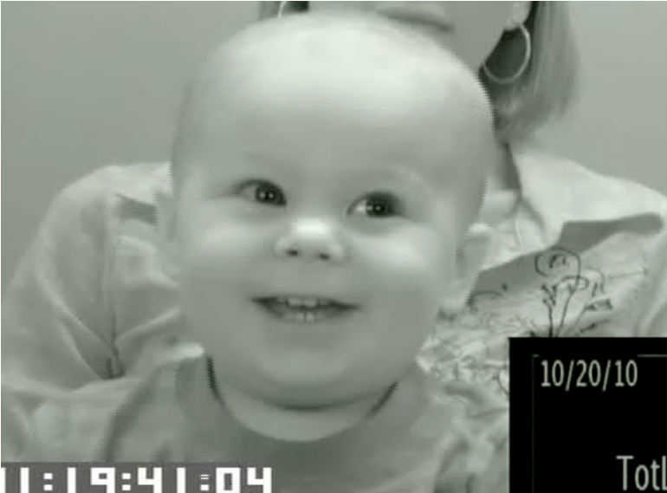
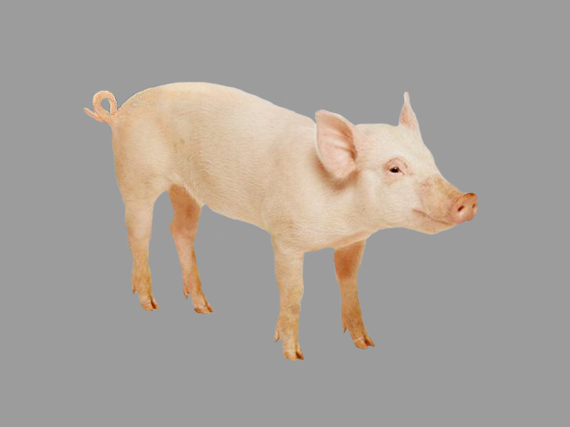
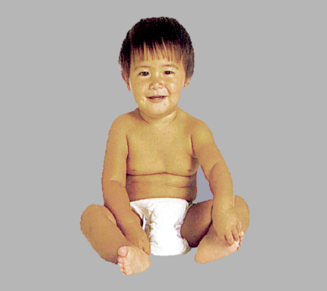
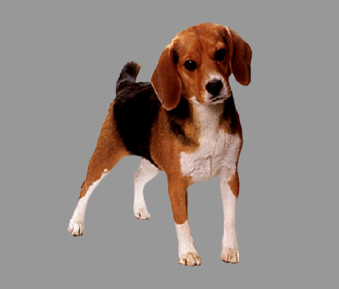
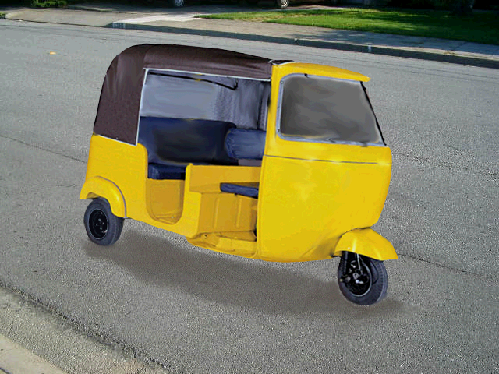
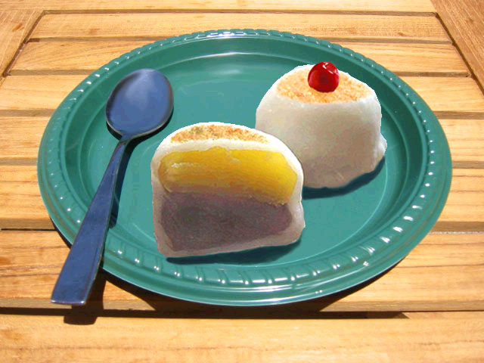
I went to the garage, and I saw a pig:
Information about location guides 30-month-olds’ attention to unnamed objects
Ricardo Bion & Anne Fernald – ricardoh@stanford.edu
Center for Infant Studies
Introduction
Studies with adults showed that location nouns prime the types of people, animals, and objects that are typically found at these locations (Hare et al., 2009)
Adults and children can use information at the verb to restrict the domain of upcoming referents (Altman & Kamide, 1999; Fernald et al., 2008)
Individual differences in children's processing of object labels relates to vocabulary size and vocabulary growth (Fernald et al., 2006)
Stimuli
Block of 12 Location-Congruent Trials:
Block of 12 Location-Incongruent Trials:
I went to the GARAGE, and I saw a CAR
I went to the FARM, and I saw a CAR
Results RQ1
I went to the GARAGE and I saw a CAR
Participants
Research Questions
I went to the FARM and I saw a CAR
RQ1: Are young children able to use the name of a location to restrict the domain of upcoming familiar referents?
RQ2: If so, is this skill related to children's concurrent vocabulary?
% looking to
target object
Location-Congruent
Location-Incongruent
Participants
RQ1: Young children are able to use the name of a location to restrict the domain of an upcoming referent.
Twenty-five 30-month-olds
Results RQ2
Discussion and current studies
Method
Are these anticipatory findings symmetrical?
In the carage I saw a CAR vs. I saw a car, in the GARAGE
Is referent selection based on priming, event-based knowledge, or object affordances?
Can this kind of inferences be used to learn new words?
I went to the garage and I saw a PIFO.
Looking-while-listening (LWL) task: Children look at two pictures while hearing a sentence naming one of the pictures. Gaze patterns are videorecorded and eye movements are coded offline.
Accuracy: proportion looking to the target vs. distracter
MacArthur-Bates Communicative Development Inventory (W&S):
Location-Congruent
Location-Incongruent
r (23) = 0.726, p < 0.001
r (23) = 0.178, p = 0.395
RQ 2: Anticipation on the location-congruent block is strongly correlated to vocabulary
Which one is the PIFO?

